Slide 1
CS 170 Final Review
Allen Tang, Raymond Chan
05/04/2017

Slide 2
Linear Programming & Max Flow

Slide 3
Linear Program
Formulating LPs
Decision Variables
Things you have control over.
Objective Function
Optimize a goal. Minimize or maximize.
Constraints
Optimize objective while satisfying restrictions to variables.

Slide 4
Duality
Suppose we have a maximization LP with an optimal value of z*. (Primal)
How do the constraints affect z*?
Suppose we have an upper bound of the LP in z_{u}, z* ≤ z_{u}.
We can minimize z_{u} such that z* = z_{u}.
The smallest upper bound must be the optimal solution to the primal LP.
We can weight the constraints in such a way to minimize the upper bound. (Dual)
These weights will upper bound the coefficients

Slide 5
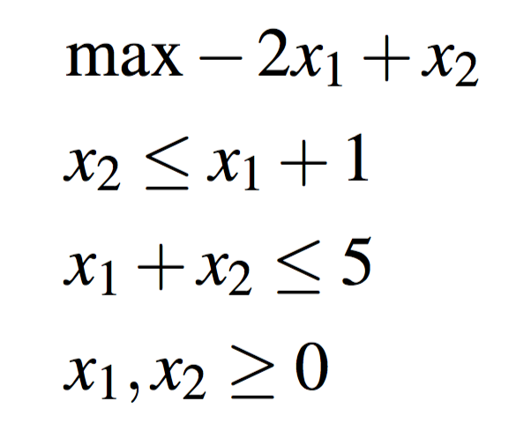
Duality
Find the dual of the following primal LP:

Slide 6
Duality
Rewriting and multiplying by y multipliers:
y₁
x₂ - x₁ ≤ 1
y₂

Slide 7
Duality
Rewriting the multipliers and constraints:
y₁ (x₂ - x₁) + y₂ (x₁ + x₂) ≤ y₁ + 5y₂

Slide 8
Duality
Rewriting the multipliers and constraints:
y₁ (x₂ - x₁) + y₂ (x₁ + x₂) ≤ y₁ + 5y₂
(-y₁ + y₂) x₁ + (y₁ + y₂) x₂ ≤ y₁ + 5y₂

Slide 9
Duality
Adding upper bound to primal objective
y₁ (x₂ - x₁) + y₂ (x₁ + x₂) ≤ y₁ + 5y₂
(-y₁ + y₂) x₁ + (y₁ + y₂) x₂ ≤ y₁ + 5y₂
-2 x₁ + x₂ ≤ (-y₁ + y₂) x₁ + (y₁ + y₂) x₂ ≤ y₁ + 5y₂

Slide 10
Duality
Writing the dual and nonnegativity constraints
-2 x₁ + x₂ ≤ (-y₁ + y₂) x₁ + (y₁ + y₂) x₂ ≤ y₁ + 5y₂
Dual
min y₁ + 5y₂
s.t. -y₁ + y₂ ≥ -2
y₁ + y₂ ≥ 1
y₁, y₂ ≥ 0

Slide 11
Duality
Writing the dual and nonnegativity constraints
-2 x₁ + x₂ ≤ (-y₁ + y₂) x₁ + (y₁ + y₂) x₂ ≤ y₁ + 5y₂
Dual
min y₁ + 5y₂
s.t. -y₁ + y₂ ≥ -2
y₁ + y₂ ≥ 1
y₁, y₂ ≥ 0
Nonnegativity constraints are added so that the sign in the primal constraints do not get flipped.

Slide 12
Duality
What is the optimal solution? What are the optimal decision variables for both the primal LP and the dual LP?
Dual:
min y₁ + 5y₂
s.t. -y₁ + y₂ ≥ -2
y₁ + y₂ ≥ 1
y₁, y₂ ≥ 0

Slide 13
Duality
What is the optimal solution? What are the optimal decision variables for both the primal LP and the dual LP?
Dual:
Optimal value is 1 (you can plot it)
x* = (0, 1)
y* = (1, 0)
min y₁ + 5y₂
s.t. -y₁ + y₂ ≥ -2
y₁ + y₂ ≥ 1
y₁, y₂ ≥ 0

Slide 14
Duality
Suppose the first constraint for the primal changes to x₂ = x₁ + 1, would the optimum change? Would the dual linear program change?
Original Dual:
min y₁ + 5y₂
s.t. -y₁ + y₂ ≥ -2
y₁ + y₂ ≥ 1
y₁, y₂ ≥ 0
z* = 1
x* = (0, 1)
y* = (1, 0)

Slide 15
Duality
Suppose the first constraint for the primal changes to x₂ = x₁ + 1, would the optimum change? Would the dual linear program change?
Looking at x*, we see that the optimal will not change. 1 ≤ 0 + 1
The current optimal values satisfy new LP.
Original Dual:
min y₁ + 5y₂
s.t. -y₁ + y₂ ≥ -2
y₁ + y₂ ≥ 1
y₁, y₂ ≥ 0
z* = 1
x* = (0, 1)
y* = (1, 0)

Slide 16
Duality
Suppose the first constraint for the primal changes to x₂ = x₁ + 1, would the optimum change? Would the dual linear program change?
Looking at x*, we see that the optimal will not change. 1 ≤ 0 + 1
The current optimal values satisfy new LP.
Dual LP will change: no nonnegativity for y₁.
Original Dual:
min y₁ + 5y₂
s.t. -y₁ + y₂ ≥ -2
y₁ + y₂ ≥ 1
y₁, y₂ ≥ 0
z* = 1
x* = (0, 1)
y* = (1, 0)

Slide 17
Zero Sum Games
Two players play a game alternating turns.
A player’s gain is the other player’s loss.
Mixed strategies are optimal:
Each player declare probability of choosing each action.
Payoff matrix is with respect to one player.

Slide 18
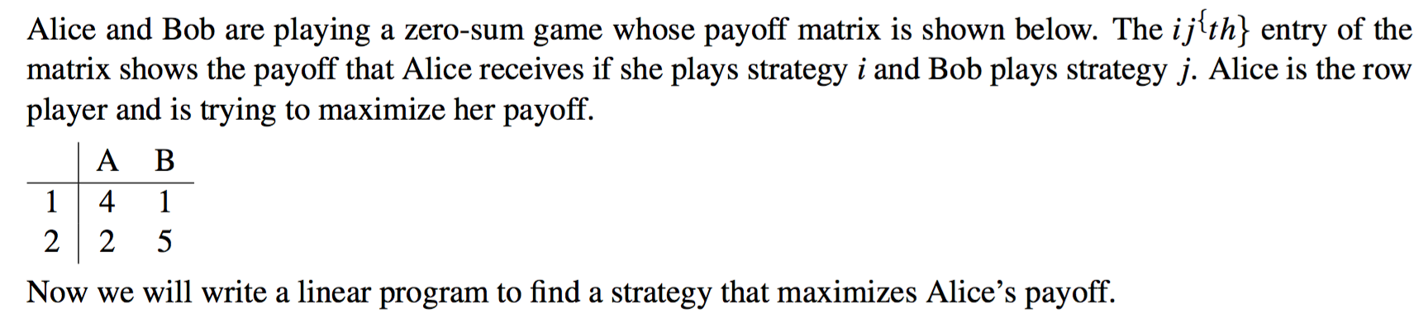
Zero Sum Games

Slide 19
Zero Sum Games
Let x_{i} be the probability that Alice plays strategy i
Bob will try to minimize Alice’s payoff.

Slide 20
Zero Sum Games
Let x_{i} be the probability that Alice plays strategy i
Bob chooses A; Alice’s payoff: 4x₁ + 2x₂
Bob chooses B; Alice’s payoff: x₁ + 5x₂

Slide 21
Zero Sum Games
Let x_{i} be the probability that Alice plays strategy i
Bob chooses A; Alice’s payoff: 4x₁ + 2x₂
Bob chooses B; Alice’s payoff: x₁ + 5x₂
Bob’s choice: min (4x₁ + 2x₂, x₁ + 5x₂)

Slide 22
Zero Sum Games
Let x_{i} be the probability that Alice plays strategy i
Bob’s choice: min (4x₁ + 2x₂, x₁ + 5x₂)
Alice’s payoff = max { min (4x₁ + 2x₂, x₁ + 5x₂) }

Slide 23
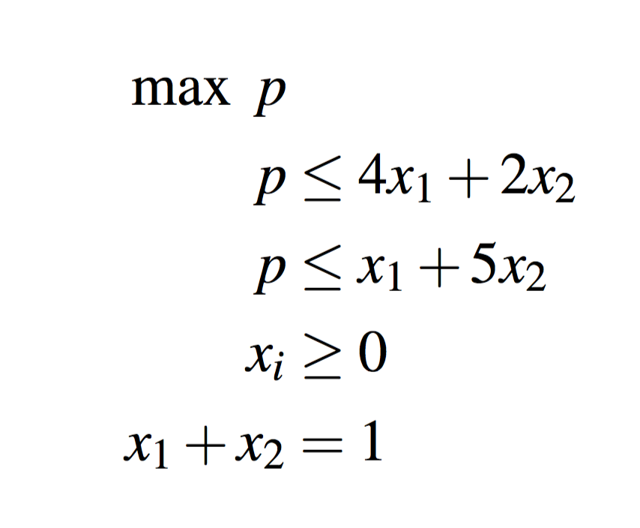
Zero Sum Games
Let x_{i} be the probability that Alice plays strategy i
Bob’s choice: min (4x₁ + 2x₂, x₁ + 5x₂)
Alice’s payoff = max { min (4x₁ + 2x₂, x₁ + 5x₂) }
Linear Program:

Slide 24
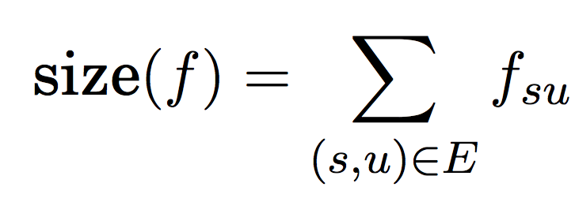
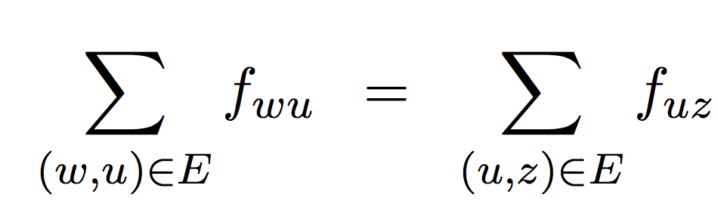
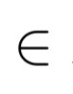
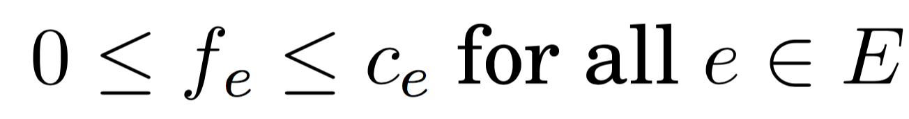
Max Flow
Given a directed graph G = (V, E), send as many units of flow from source s to sink t
Satisfying positive edge capacity constraints.
The number of units send from s must be received by t.
max
s.t.
for all u V Flow conservation constraints.
Capacity constraints.

Slide 25
Max Flow
Ford-Fulkerson algorithm
When sending x units of flow, build up residual edges.
Keep sending units of low until no path is available between s and t in the residual graph.
Edmond-Karp algorithm: send as many units of flow as possible through shortest s-t path (BFS)
O(|V||E|²)

Slide 26
Max Flow
A
B
3
3
4
S
2
2
T
2
3
C
4
D
How many units of flow can we send through SCDBT?
Draw the residual graph after sending that many units of flow.

Slide 27
Max Flow
A
B
3
2
1
4
S
2
2
T
3
2
C
2
D
2
How many units of flow can we send through SCDBT? 2
Draw the residual graph after sending that many units of flow.

Slide 28
Max Flow
A
B
3
2
1
4
S
2
2
T
3
2
C
2
D
2
Now find the max flow for the graph.

Slide 29
Max Flow
A
B
3
2
1
4
S
2
2
T
3
2
C
2
D
2
Send 2 units of flow through SCDBT
Send 2 units of flow through SABDT

Slide 30
Max Flow
2
A
B
1
2
2
1
2
S
2
2
T
1
2
2
C
2
D
2
Send 2 units of flow through SCDBT
Send 2 units of flow through SABDT

Slide 31
Max Flow
2
A
B
1
2
2
1
2
S
2
2
T
1
2
2
C
2
D
2
Send 2 units of flow through SCDBT Send 1 unit of flow through SABT
Send 2 units of flow through SABDT

Slide 32
Max Flow
3
A
B
3
3
1
S
2
2
T
1
2
2
C
2
D
2
Send 2 units of flow through SCDBT Send 1 unit of flow through SABT
Send 2 units of flow through SABDT

Slide 33
Max Flow
3
A
B
3
3
1
S
2
2
T
1
2
2
C
2
D
2
Send 2 units of flow through SCDBT Send 1 unit of flow through SABT
Send 2 units of flow through SABDT Send 1 unit of flow through SACDT

Slide 34
Max Flow
3
A
B
4
3
S
1
1
2
T
2
3
C
1
D
3
Send 2 units of flow through SCDBT Send 1 unit of flow through SABT
Send 2 units of flow through SABDT Send 1 unit of flow through SACDT

Slide 35
Max Flow
3
A
B
4
3
S
1
1
2
T
2
3
C
1
D
3
Send total 6 units of flow

Slide 36
Max Flow
3
A
B
4
3
S
1
1
2
T
2
3
C
1
D
3
What is the minimum cut?

Slide 37
Max Flow
3
A
B
4
3
S
1
1
2
T
2
3
C
1
D
3
What is the minimum cut?
{S}, {A, B, C, D, T}

Slide 38
Max Flow
3
A
B
4
3
S
1
1
2
T
2
3
C
1
D
3
What is the minimum cut?
{S}, {A, B, C, D, T} or {S, A, B, C, D}, {T}

Slide 39
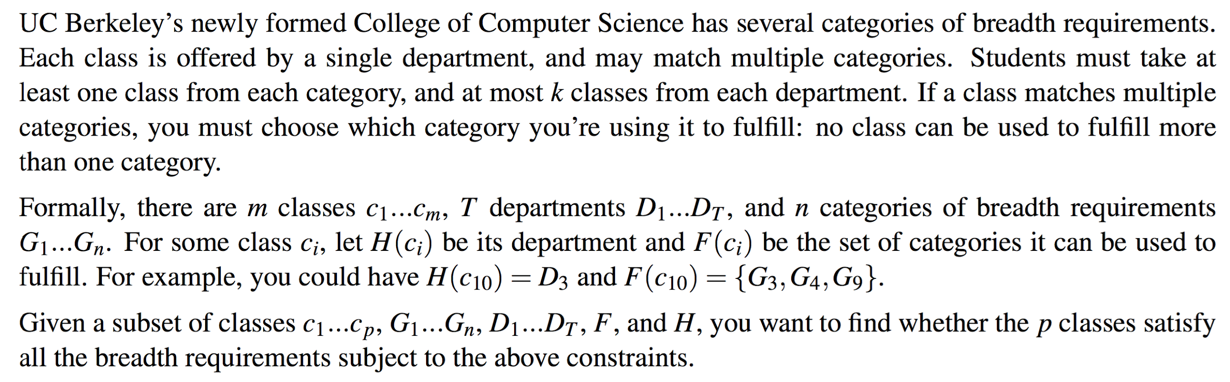
Breadth Requirements (Spring 2016 MT2)

Slide 40
Breadth Requirements (Spring 2016 MT2)
What are the decision variables?

Slide 41
Breadth Requirements (Spring 2016 MT2)
What are the decision variables?
There are m classes, T departments, and n requirements.
The departments are part of constraints.
Let x_{ij} be an indicator variable indicating if the i-th class is being used to satisfy the j-th requirement.

Slide 42
Breadth Requirements (Spring 2016 MT2)
What are the decision variables?
There are m classes, T departments, and n requirements.
The departments are part of constraints.
Let x_{ij} be an indicator variable indicating if the i-th class is being used to satisfy the j-th requirement.
What is the objective function?

Slide 43
Breadth Requirements (Spring 2016 MT2)
What are the decision variables?
There are m classes, T departments, and n requirements.
The departments are part of constraints.
Let x_{ij} be an indicator variable indicating if the i-th class is being used to satisfy the j-th requirement.
What is the objective function?
The question cares about feasibility rather than optimizing.
Obj Func: max 0
Let’s now talk through the constraints.

Slide 44
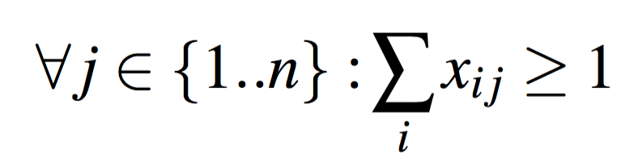
Breadth Requirements (Spring 2016 MT2)
For each breadth, at least one class is used to satisfy it.

Slide 45
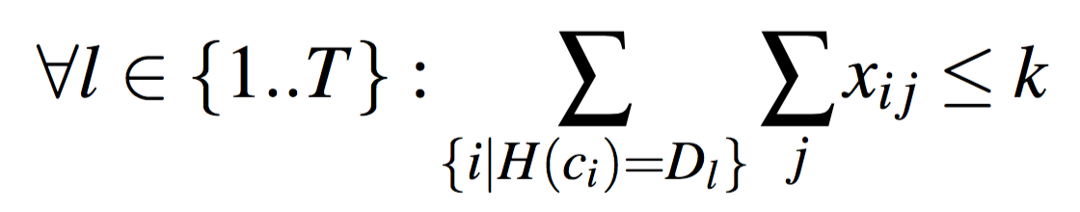
Breadth Requirements (Spring 2016 MT2)
For each breadth, at least one class is used to satisfy it.
For each department, at most k courses can be used to satisfy all requirements.

Slide 46
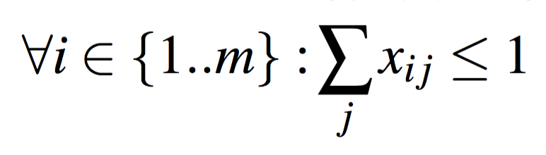
Breadth Requirements (Spring 2016 MT2)
For each breadth, at least one class is used to satisfy it.
For each department, at most k courses can be used to satisfy all requirements.
Each class can only satisfy at most one requirement.

Slide 47
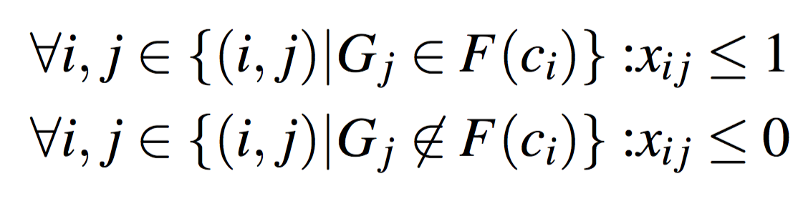
Breadth Requirements (Spring 2016 MT2)
For each breadth, at least one class is used to satisfy it.
For each department, at most k courses can be used to satisfy all requirements.
Each class can only satisfy at most one requirement.
We can only use classes to satisfy requirements that they can satisfy.

Slide 48
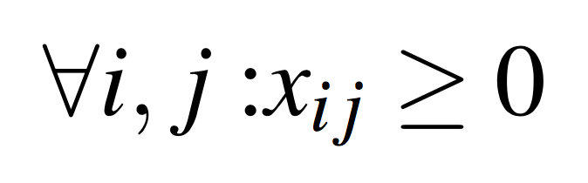
Breadth Requirements (Spring 2016 MT2)
For each breadth, at least one class is used to satisfy it.
For each department, at most k courses can be used to satisfy all requirements.
Each class can only satisfy at most one requirement.
We can only use classes to satisfy requirements that they can satisfy.
Lower bound for decision variables. Upper bound implicit from 3rd constraint.

Slide 49
Breadth Requirements (Spring 2016 MT2)

Slide 50
Breadth Requirements (Spring 2016 MT2)
Reduce to max flow instance and solve in a way similar to bipartite matching.
Graph consist of vertices of requirements, classes, and departments.
Add source and sink nodes.
g₁
c₁
d₁
g₂
c₂
d₂
.
.
.
.
.
.
.
.
.
s
t
g_{n}
c_{p}
d_{T}

Slide 51
Breadth Requirements (Spring 2016 MT2)
Reduce to max flow instance and solve in a way similar to bipartite matching.
Need to satisfy each requirement.
Add edge (s, g_{j}) with edge weight 1.
g₁
c₁
d₁
1
1
g₂
c₂
d₂
1
.
.
.
.
.
.
.
.
.
s
t
1
g_{n}
c_{p}
d_{T}

Slide 52
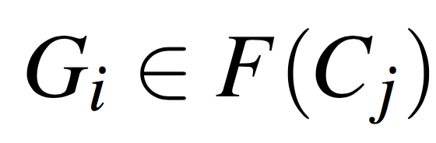
Breadth Requirements (Spring 2016 MT2)
Reduce to max flow instance and solve in a way similar to bipartite matching.
If ,
add edge
Add edge only if requirement can be satisfied with that class.
Each requirement is satisfied by a unique class.
g₁
c₁
d₁
1
1
1
g₂
c₂
d₂
1
1
.
.
.
.
.
.
.
.
.
s
t
1
1
g_{n}
c_{p}
d_{T}

Slide 53
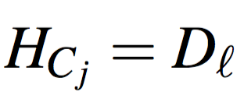
Breadth Requirements (Spring 2016 MT2)
Reduce to max flow instance and solve in a way similar to bipartite matching.
If ,
add edge
If ,
add edge
Add edge only if the class can satisfy the requirement.
Each class belongs to only one department. Thus edge capacity of 1.
g₁
c₁
d₁
1
1
1
1
g₂
c₂
1
d₂
1
1
.
.
.
.
.
.
.
.
.
s
t
1
1
1
g_{n}
c_{p}
d_{T}

Slide 54
Breadth Requirements (Spring 2016 MT2)
Reduce to max flow instance and solve in a way similar to bipartite matching.
If ,
add edge
If ,
add edge
If ,
add edge
If ,
add edge
No more than k classes can be satisfy each requirement.
g₁
c₁
d₁
1
1
k
1
1
1
g₂
c₂
1
d₂
k
1
1
.
.
.
.
.
.
.
.
.
k
s
t
1
1
1
k
g_{n}
c_{p}
d_{T}

Slide 55
Breadth Requirements (Spring 2016 MT2)
There is a satisfying assignment if size of max flow = n (number of requirements).
If ,
add edge
If ,
add edge
If ,
add edge
If ,
add edge
The flow can go in the other direction.
g₁
c₁
d₁
1
1
k
1
1
1
g₂
c₂
1
d₂
k
1
1
.
.
.
.
.
.
.
.
.
k
s
t
1
1
1
k
g_{n}
c_{p}
d_{T}

Slide 56
Complexity

Slide 57
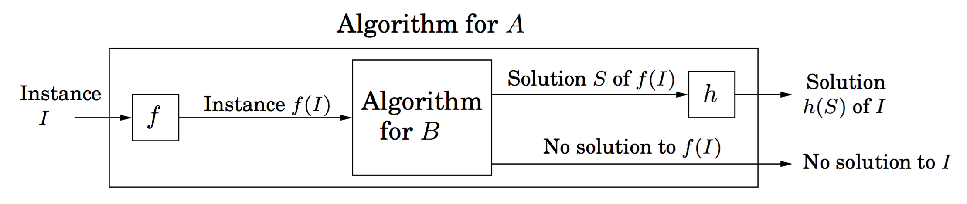
Reduction
Reduce A to B.
B is at least as hard as A

Slide 58
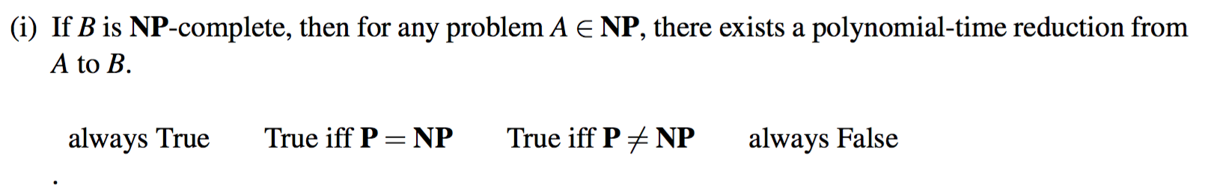
Spring 2016 Final

Slide 59
Spring 2016 Final

Slide 60
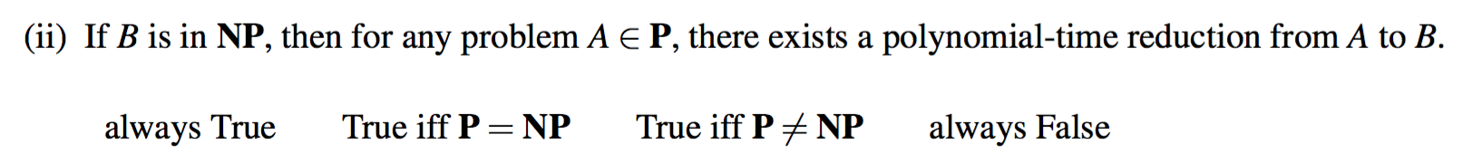
Spring 2016 Final

Slide 61
Spring 2016 Final

Slide 62
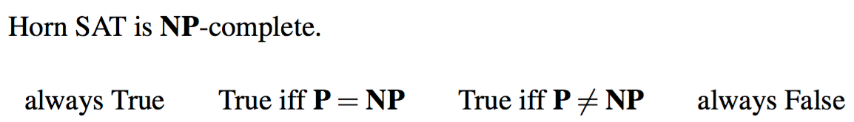
Spring 2016 Final

Slide 63
Spring 2016 Final

Slide 64
Definitions
P: Set of all problems that can be solved (and verified) in polynomial time.
NP: Set of all problems that can be verified in polynomial time.
NP-Hard: Set of all problems that are at least as hard as the hardest problem in NP
A problem A is in NP-Hard, when every problem B in NP can be reduced to A in polynomial time.
NP-Complete: Set of problems in NP-Hard that can be verified in polynomial time.
Subset of NP-Hard problems.

Slide 65
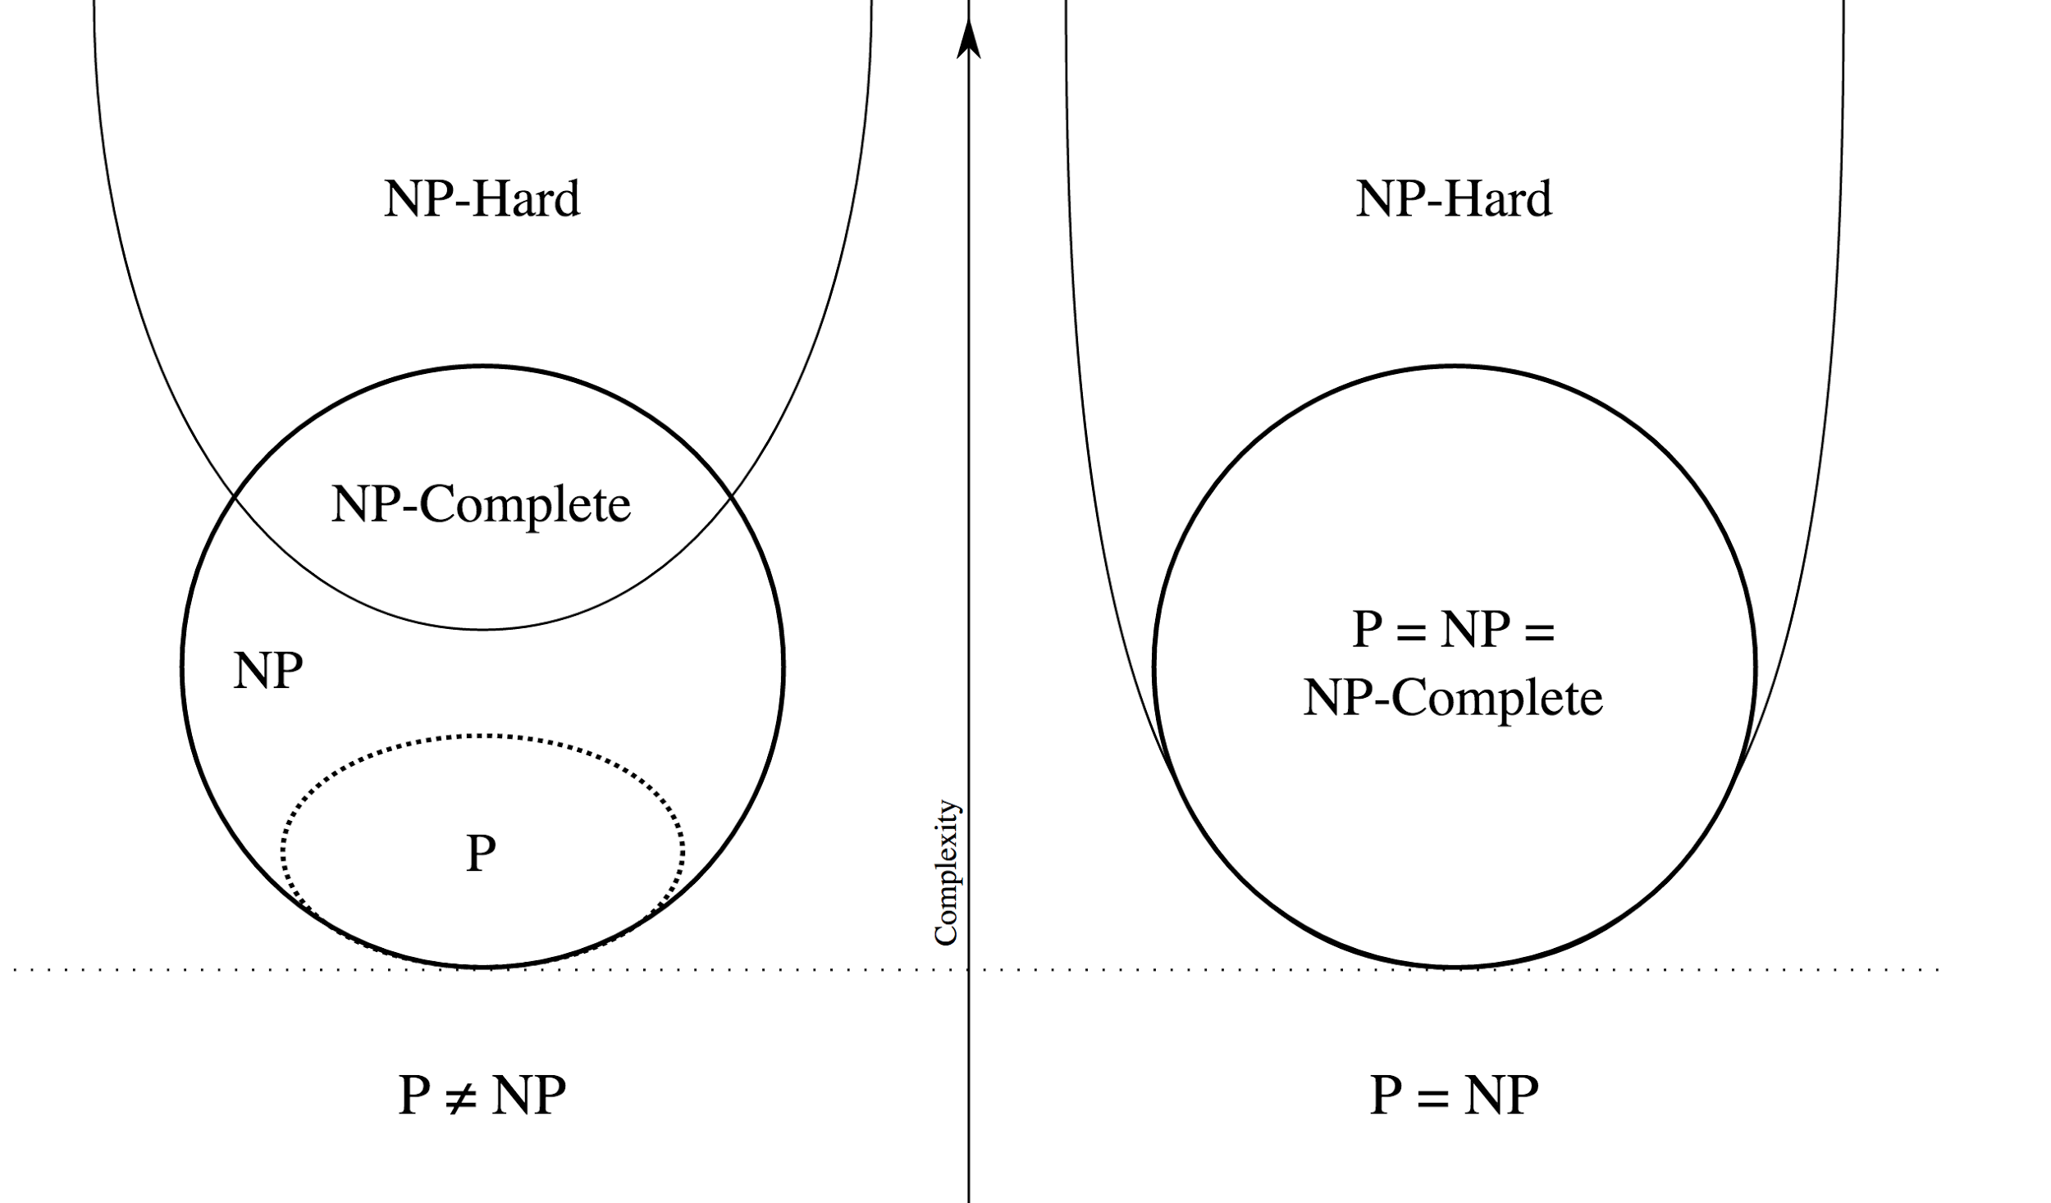
Showing NP-Completeness
Show problem A is in NP
Show that there is a polynomial time verifier.
Show that problem A is NP-Hard
Reduce NP-Hard problem to A, or
Reduce NP-Complete problem to A

Slide 66
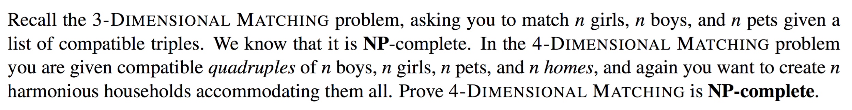
4D Matching

Slide 67
4D Matching
Show in NP:
A solution to 4D matching can be verified in polynomial time by verifying every boy, girl, pet, home is assigned to exactly one household and vice-versa.

Slide 68
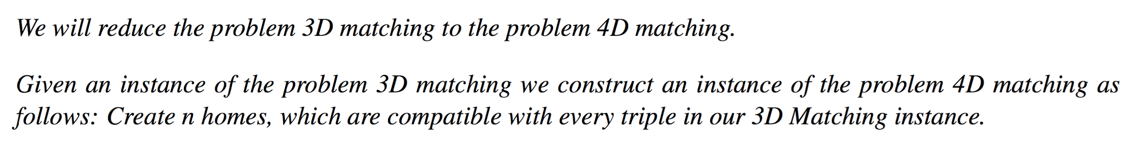
4D Matching
Show in NP-Hard:
Any quadruple that 4D matching considers are not affected by any of the homes.

Slide 69
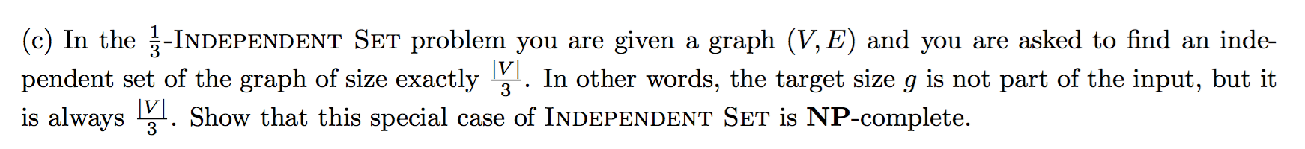
⅓ Independent Set

Slide 70
⅓ Independent Set
Show in NP:
A solution to 1/3 Independent Set can be verified in polynomial time by checking that there are no edges between the nodes of the independent set and checking its size.

Slide 71
⅓ Independent Set
Show in NP-Hard:
Reduce independent set (w/ target size g) to ⅓ independent set.
If g = |V|/3, no modifications.

Slide 72
⅓ Independent Set
Show in NP-Hard:
Reduce independent set (w/ target size g) to ⅓ independent set.
If g > |V|/3,

Slide 73
⅓ Independent Set
Show in NP-Hard:
Reduce independent set (w/ target size g) to ⅓ independent set.
If g > |V|/3, add x vertices

Slide 74
⅓ Independent Set
Show in NP-Hard:
Reduce independent set (w/ target size g) to ⅓ independent set.
If g > |V|/3, add x vertices such that g = (|V| + x) / 3

Slide 75
⅓ Independent Set
Show in NP-Hard:
Reduce independent set (w/ target size g) to ⅓ independent set.
If g > |V|/3, add x vertices such that g = (|V| + x) / 3
Add x = 3g - |V|

Slide 76
⅓ Independent Set
Show in NP-Hard:
Reduce independent set (w/ target size g) to ⅓ independent set.
If g > |V|/3, add x vertices such that g = (|V| + x) / 3
Add x = 3g - |V|
New vertices have edges to each other and original vertices

Slide 77
⅓ Independent Set
Show in NP-Hard:
Reduce independent set (w/ target size g) to ⅓ independent set.
If g < |V|/3,

Slide 78
⅓ Independent Set
Show in NP-Hard:
Reduce independent set (w/ target size g) to ⅓ independent set.
If g < |V|/3, add x vertices such that g + x = (|V|+x) / 3

Slide 79
⅓ Independent Set
Show in NP-Hard:
Reduce independent set (w/ target size g) to ⅓ independent set.
If g < |V|/3, add x vertices such that g + x = (|V|+x) / 3
x = (|V| - 3g) / 2
3g + 3x = |V| + x
2x = |V| - 3g

Slide 80
⅓ Independent Set
Show in NP-Hard:
Reduce independent set (w/ target size g) to ⅓ independent set.
If g < |V|/3, add x vertices such that g + x = (|V|+x) / 3
x = (|V| - 3g) / 2
New vertices are isolated
3g + 3x = |V| + x
2x = |V| - 3g

Slide 81
⅓ Independent Set
Show in NP-Hard:
After solving vai ⅓ independent set, return only vertices in original graph.

Slide 82
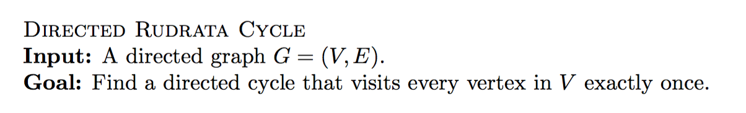
Proving NP-Hard (Fall 2015 Final)

Slide 83
Proving NP-Hard (Fall 2015 Final)

Slide 84
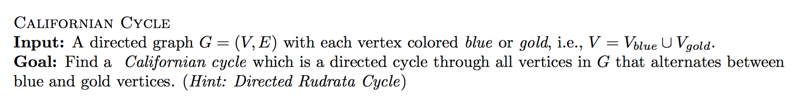
Proving NP-Hard (Fall 2015 Final)

Slide 85
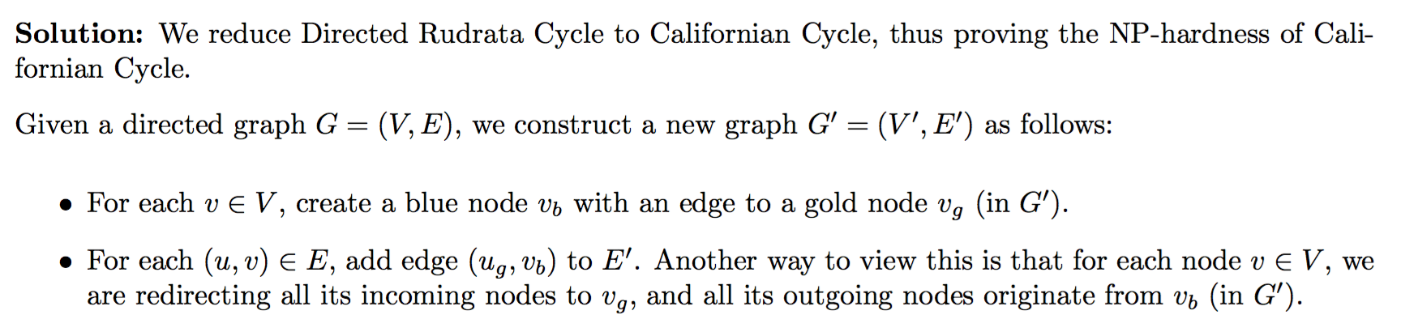
Proving NP-Hard (Fall 2015 Final)

Slide 86
Approximation Algorithms

Slide 87
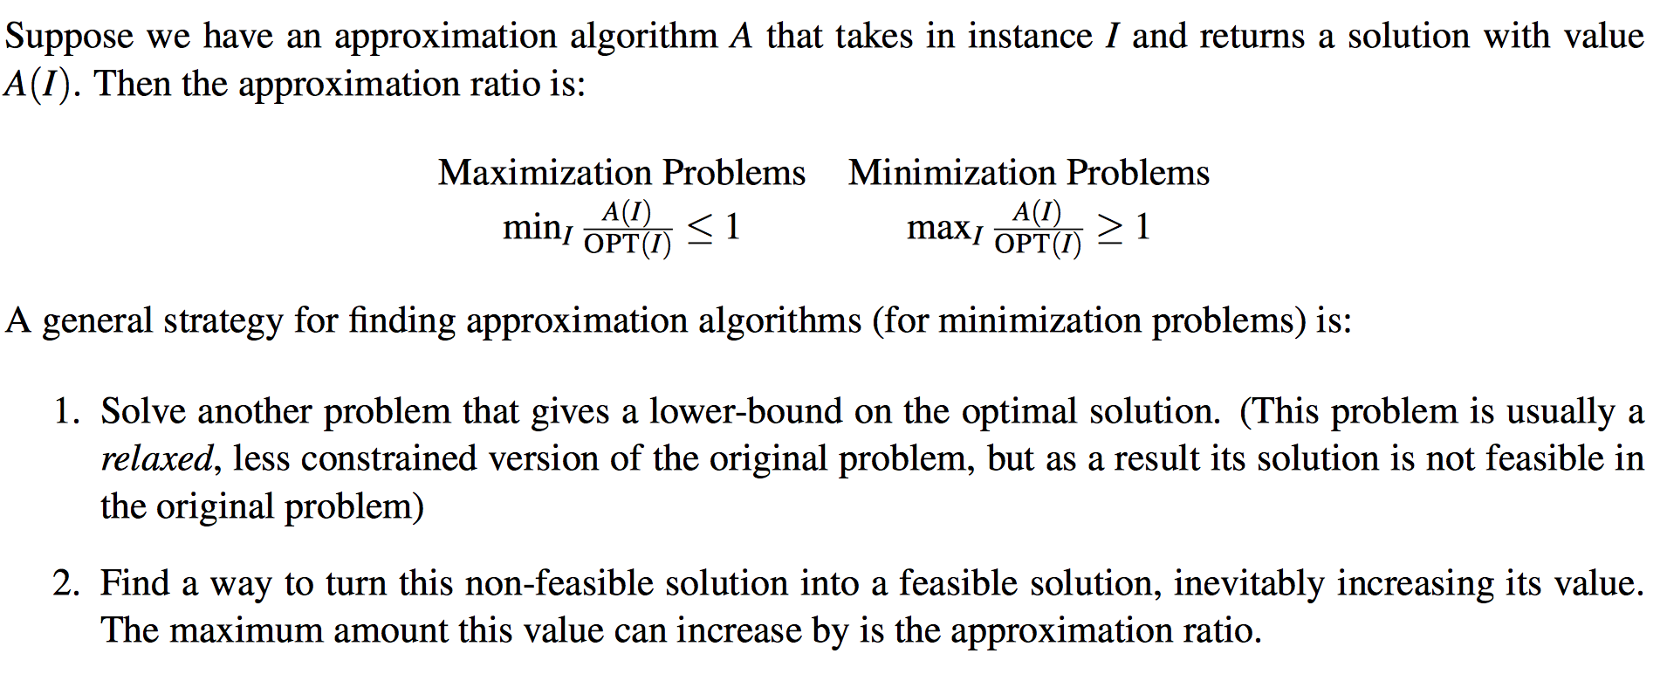
General Strategy

Slide 88
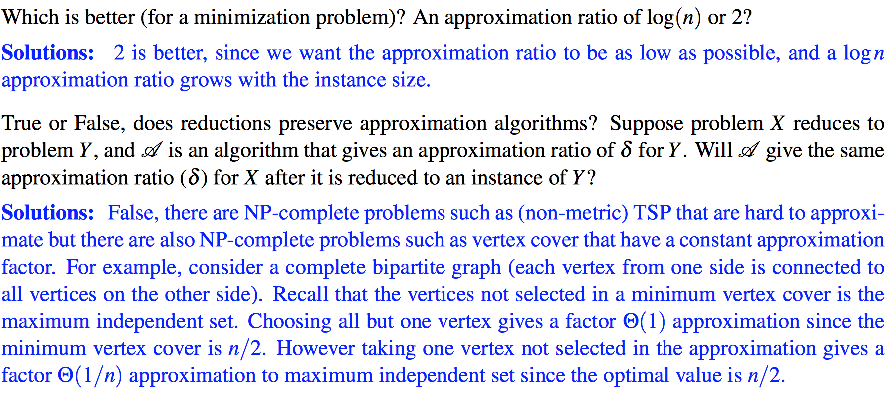
Conceptual Questions

Slide 89
Conceptual Questions

Slide 90
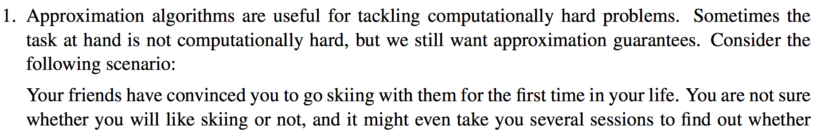
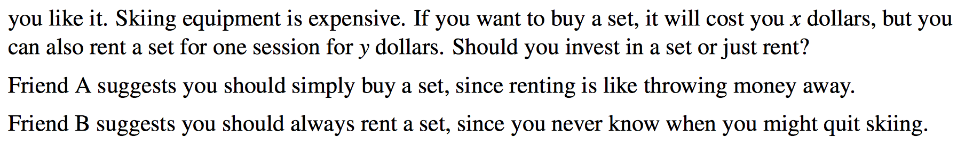
Practice Questions

Slide 91
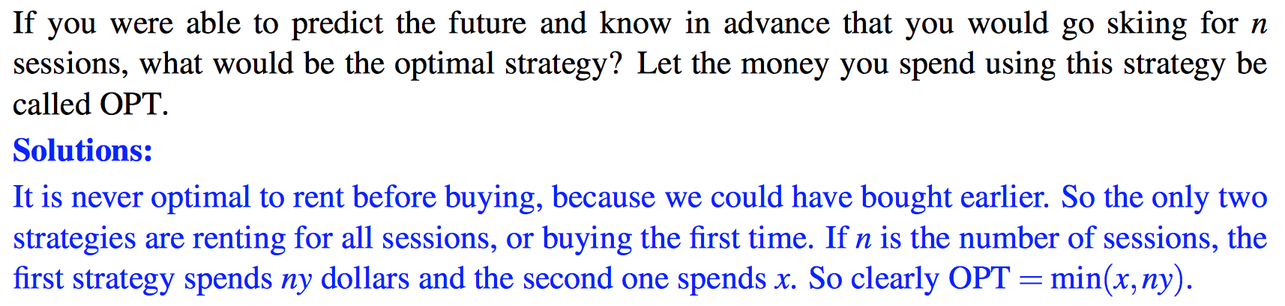
Practice Questions (cont.)

Slide 92
Practice Questions (cont.)

Slide 93
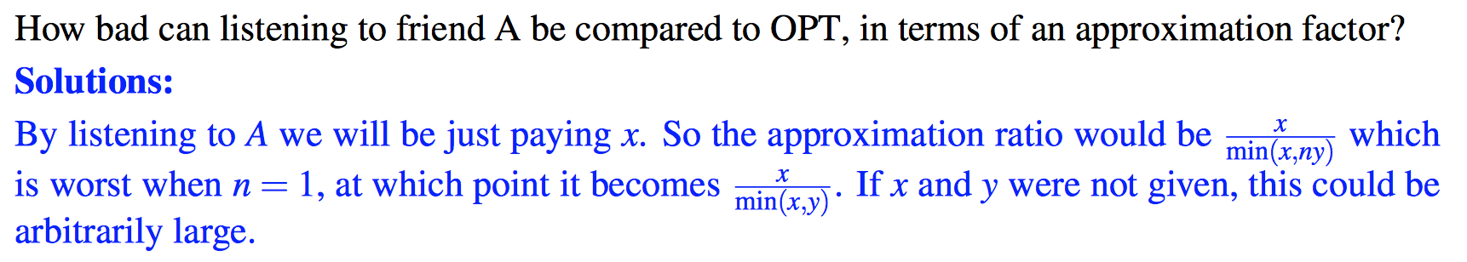
Practice Questions (cont.)

Slide 94
Practice Questions (cont.)

Slide 95
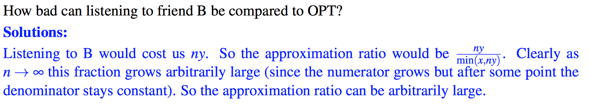
Practice Questions (cont.)

Slide 96
Practice Questions (cont.)

Slide 97
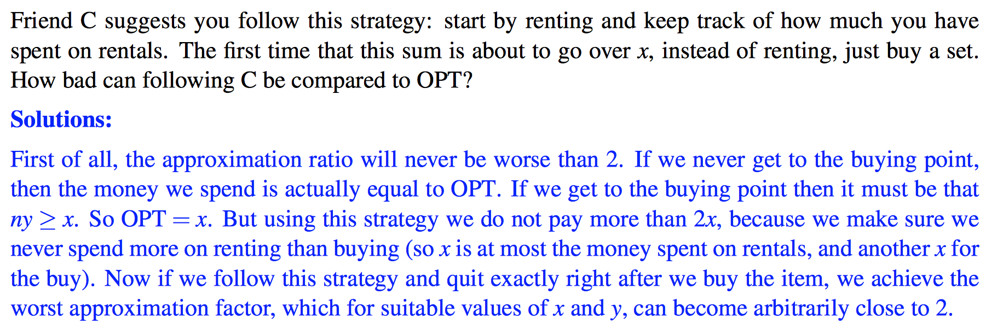
Practice Questions (cont.)

Slide 98
Practice Questions (cont.)

Slide 99
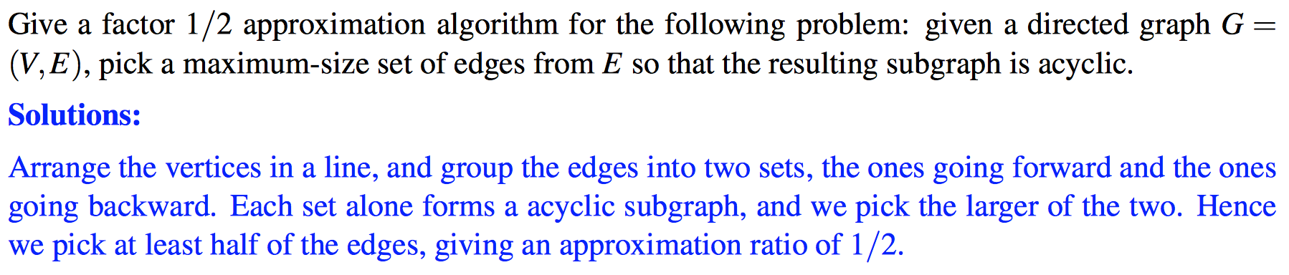
Practice Questions

Slide 100
Practice Questions

Slide 101
Special Topics

Slide 102
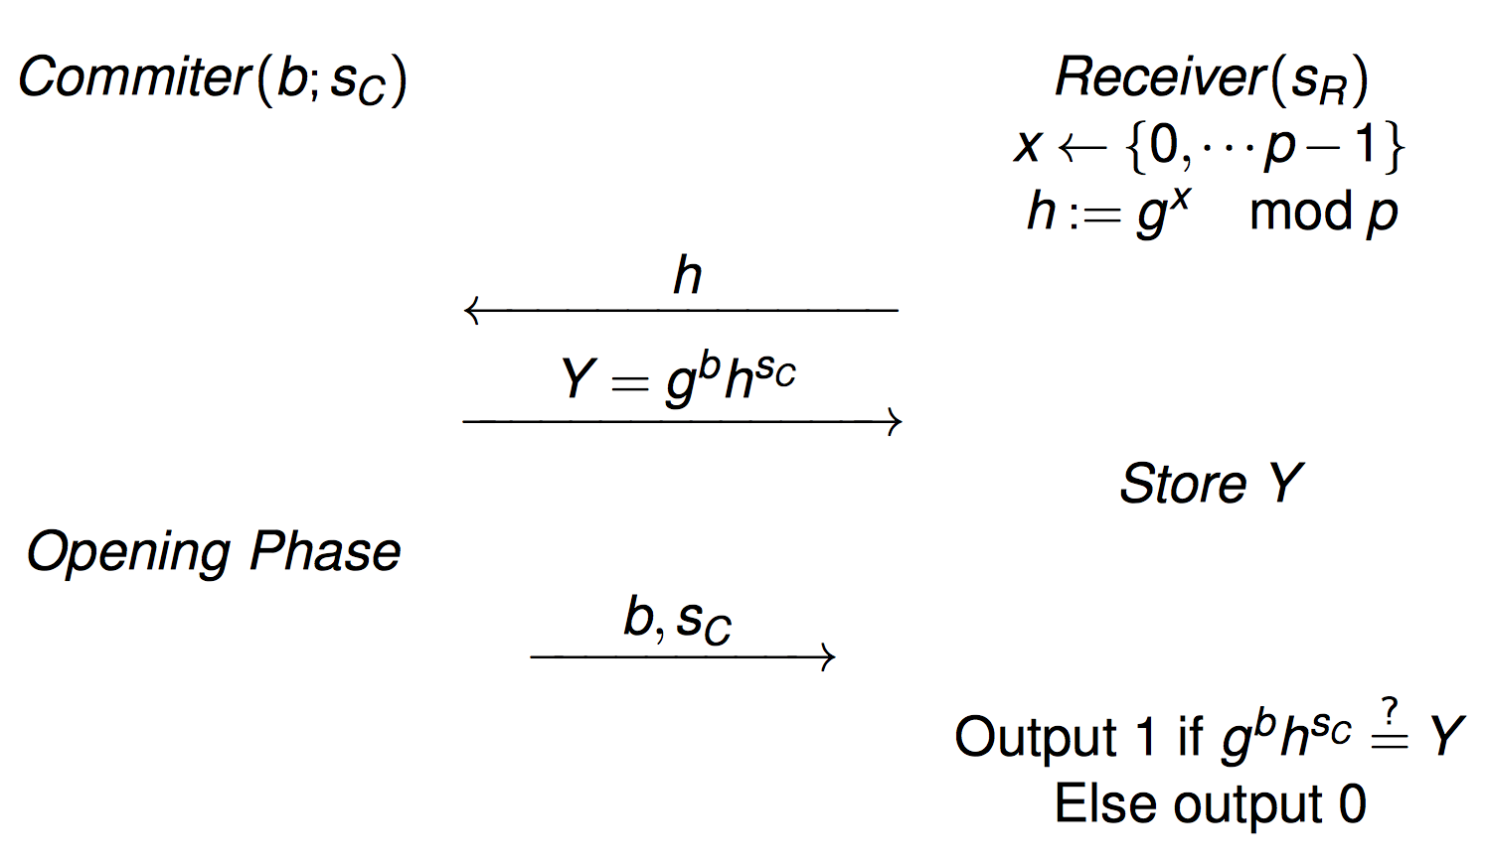
Cryptography
Commitment Proctol
Allows one to commit to a chosen value while keeping it hidden to others, with the ability to reveal the committed value later

Slide 103
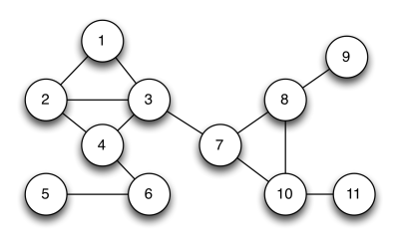
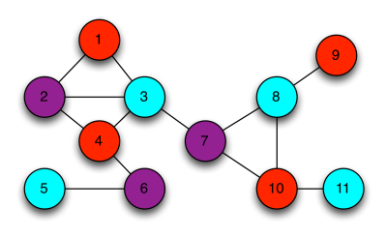
Graph Three-Coloring
The decision problem of whether a given graph supports a solution with three colors is known to be in the complexity class NP-Complete.
Since the problem is hard, we can outsource it to ask someone who is smarter is solve it. The problem now is how I can verify that he/she has the wisdom to solve the problem.

Slide 104
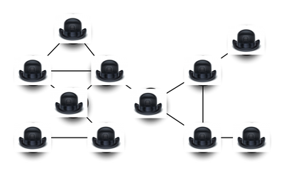
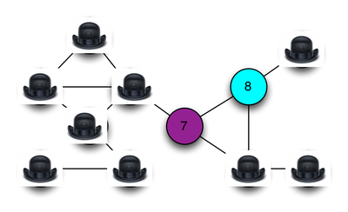
Zero-Knowledge Proof System
You draw the graph G and give it to your smart friend, say Raymond.
Raymond only needs to show you he is capable of solving the problem. He does not want to give you the solutions easily. So he covers all his solutions with hats.
But how can you make sure Raymond is actually capable of solving it?
You decided to randomly ask Raymond to reveal the coloring for an edge to verify that he is not lying.

Slide 105
Zero-Knowledge Proof System
Two outcomes from the experiment before:
If the two revealed vertices are the same color or aren’t colored in at all, then I know for sure that Raymond is lying
If the two revealed vertices are different colors, then Raymond might not be lying to me.
But what’s the probability that Raymond can still cheat? (E-1)/E
I can ask Raymond to randomly show me the coloring of another edge. If again, both vertices are different colors, what’s the probability that Raymond can cheat? ((E-1)/E)²
After a lot of iterations, I will be confident that Raymond is not lying.
Raymond also protects his algorithm/solution!! (he randomly chooses a different set of colors each time)

Slide 106
Zero-Knowledge Proof System
An interactive proof system involves a prover and a verifier
Idea: the prover proves a statement to the verifier without revealing anything except the fact that the statement is true
Zero-knowledge proof of knowledge (ZKPK): prover convinces verifier that he knows a secret without revealing the secret
Properties:
Completeness: If both prover and verifier are honest, protocol succeeds with overwhelming probability
Soundness: No one who does not know the secret can convince the verifier with nonnegligible probability. The protocol should not enable prover to prove a false statement
Zero knowledge: The proof does not leak any information

Slide 107
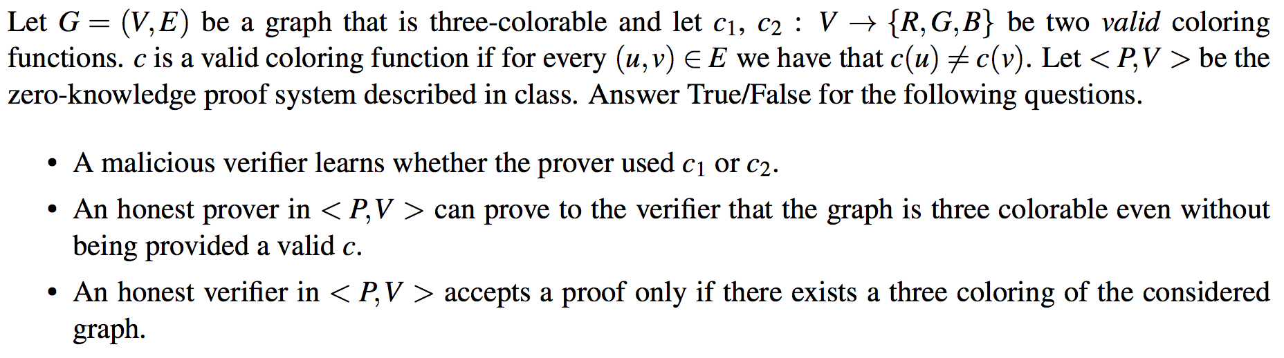
Cryptography
Practice Problems:

Slide 108
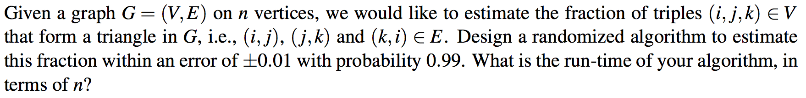
Sampling
Practice Problems:

Slide 109
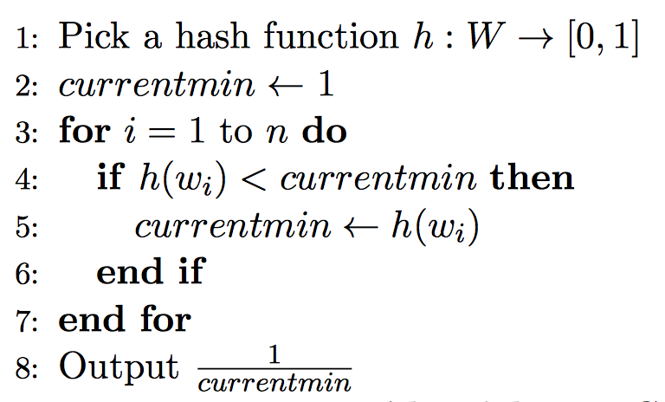
Streaming
Distinct Element Algorithms:

Slide 110
Streaming
Practice Problems:

Slide 111
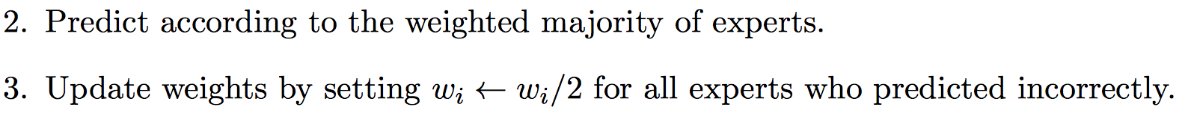
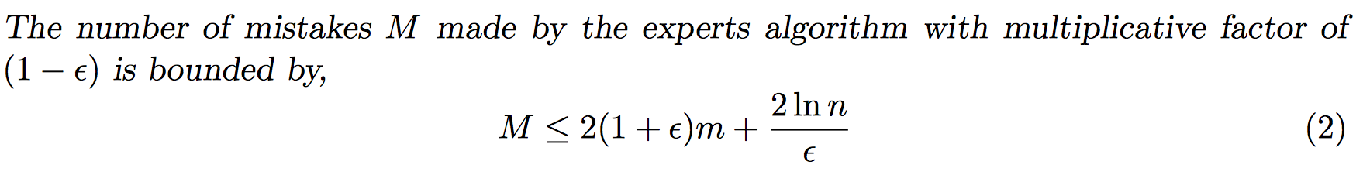
Multiplicative Weights Update Algorithm
Weighted Majority Algorithm:

Slide 112
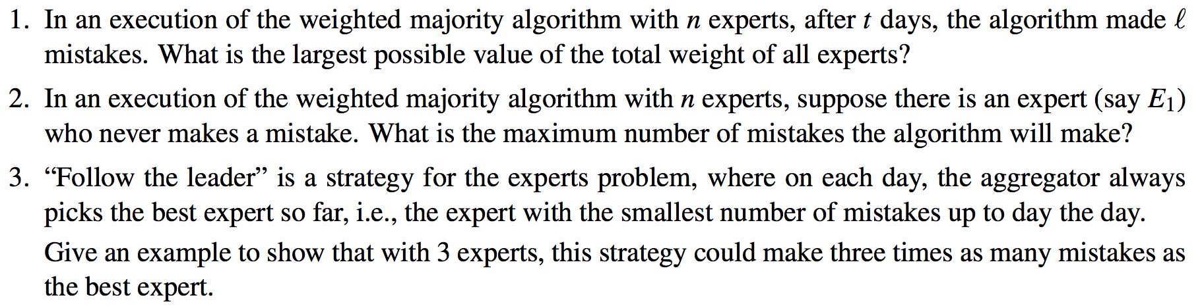
Weighted Majority Algorithm
Practice Problems:

Slide 113
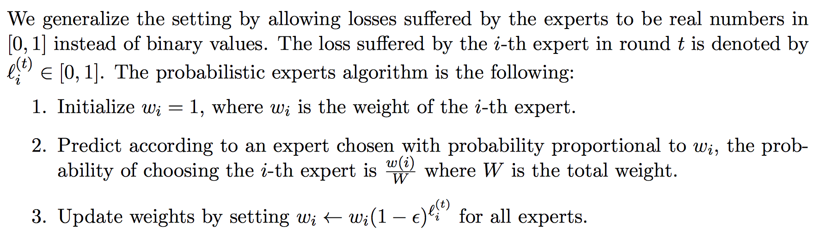
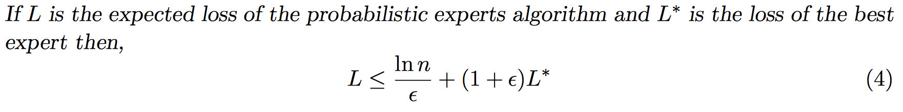
Multiplicative Weights Update Algorithm
Probabilistic Experts Algorithm:

Slide 114
Multiplicative Weights Update Algorithm
Practice Problems:

